Slide 1

AI-Driven Sentiment
Analysis Framework
China Subba Rao Koduri
Roll No - 13
02190693

Slide 2
Introduction
Objectives
Develop a scalable sentiment analysis pipeline capable of processing and interpreting large volumes of textual
data using modern NLP and machine learning techniques.
Enable data-driven decision-making by extracting emotional insights from user feedback,
reviews, and social media content to support business intelligence and customer experience strategies.
Tools Used
Python
Libraries: NLTK, Scikit-Learn, TensorFlow, Pandas, Matplotlib, Seaborn

Slide 3
Problem Definition
Significance of Sentiment Analysis: This project leverages sentiment analysis to uncover emotional cues embedded in textual data. Analyzing public expressions from platforms like reviews, social media, or surveys empowers industries such as commerce, governance, and public service to better understand community perspectives and improve decision-making related to products, policies, and services.
Key Challenges & Applied Solutions:
The project addresses critical hurdles like processing vast and rapidly growing textual data streams,delivering quick yet reliable sentiment insights. It also deals with the nuanced task of interpreting complex language patterns, including irony and sarcasm, by employing advanced NLP models and optimized classification techniques.

Slide 4
Dataset
The datasets "twitter_training.csv" and "twitter_validation.csv" are utilized to perform sentiment detection, text categorization, and various natural language processing tasks based on Twitter data. The training dataset, generally larger, is used to teach the model how to identify linguistic patterns and associate them with specific outcomes.
In contrast, the validation dataset serves to evaluate the model's performance on previously unseen data, helping to fine-tune the model and ensure its predictions remain accurate and consistent. These datasets emphasize the analysis of user-generated Twitter content, such as public opinions, trending discussions, and behavior patterns, contributing to the development of intelligent systems capable of interpreting real-world social media interactions with high precision.

Slide 5
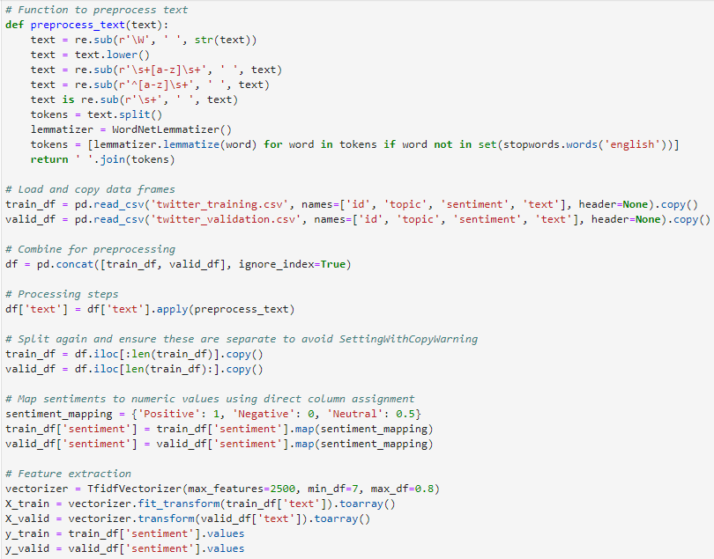
Data Preprocessing
Data Preparation:
Begin by refining the raw text data through processes such as noise reduction, sentence segmentation, and text normalization. This includes eliminating irrelevant characters, breaking text into manageable units, and standardizing word forms to ensure consistency across the dataset.
Feature Engineering:
Leverage natural language processing tools like NLTK or SpaCy to derive meaningful attributes from the cleaned text. This step may involve calculating term importance, generating vector representations, or capturing linguistic patterns essential for model training.

Slide 6
Model Architecture and Training
Neural Network Architecture:
A TensorFlow Sequential model is employed to construct the neural network by layering components in a straightforward, linear manner. This approach is well-suited for diverse prediction tasks, allowing each layer to build upon the previous one to capture complex data relationships.
Model Configuration:
Before training begins, the model undergoes compilation, where key elements like the optimization algorithm and loss function are defined. For binary sentiment classification, a loss function such as binary cross-entropy is selected to measure how far the model’s predictions deviate from actual labels.
Training and Evaluation Process:
The model learns by processing inputs through its layers, computing errors in predictions, and adjusting internal weights using backpropagation. This cycle repeats over multiple iterations, with validation data used to monitor the model's ability to generalize and maintain accuracy on unseen inputs.

Slide 7
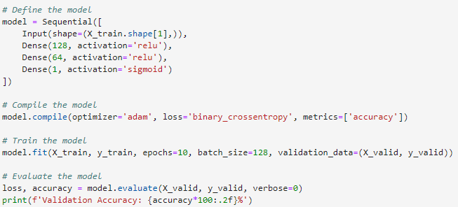
Defining the Model

Slide 8
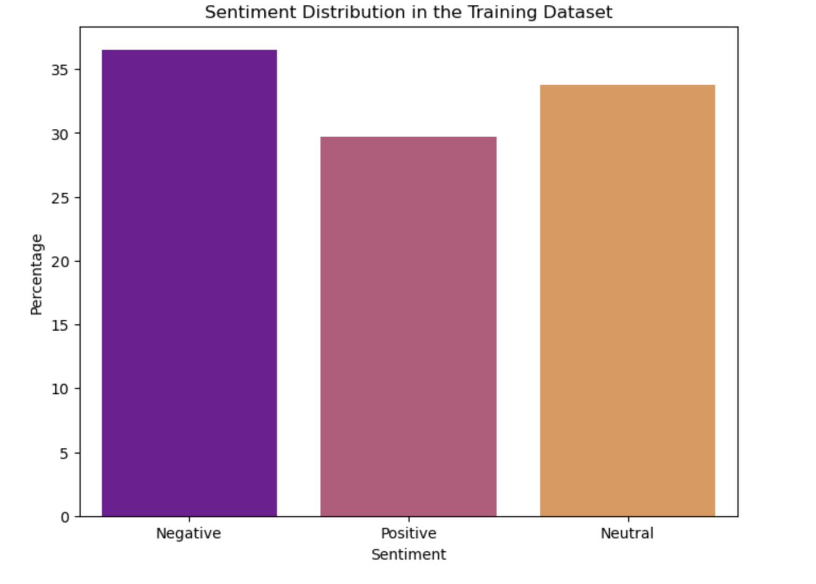
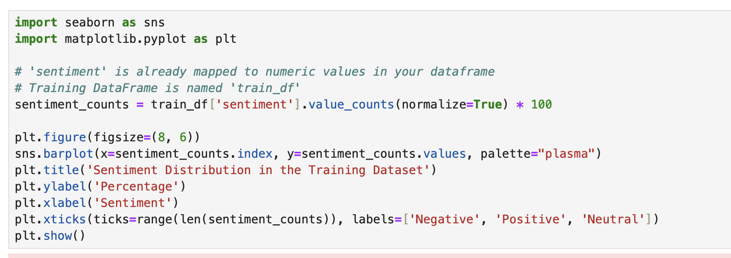
Bar Plot

Slide 9
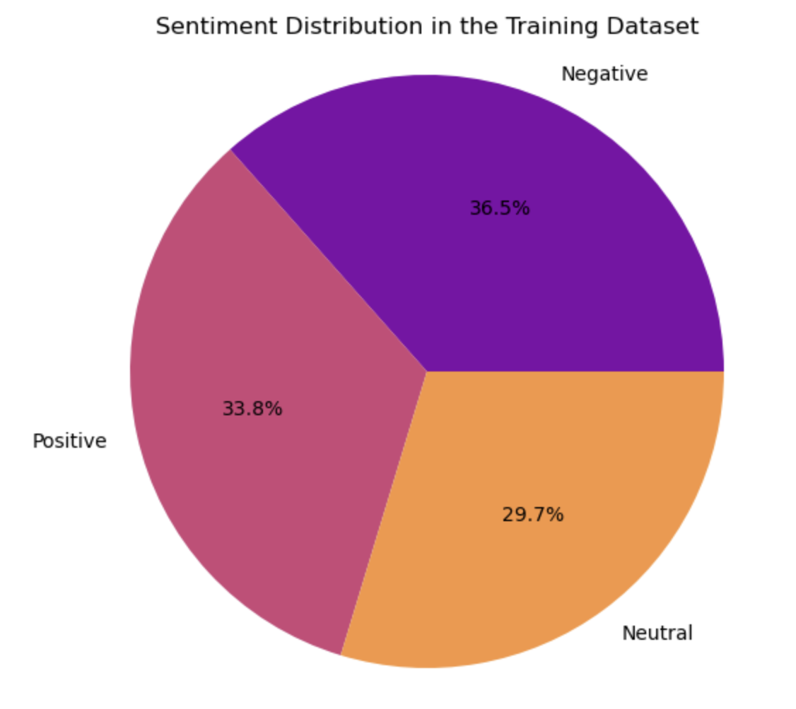
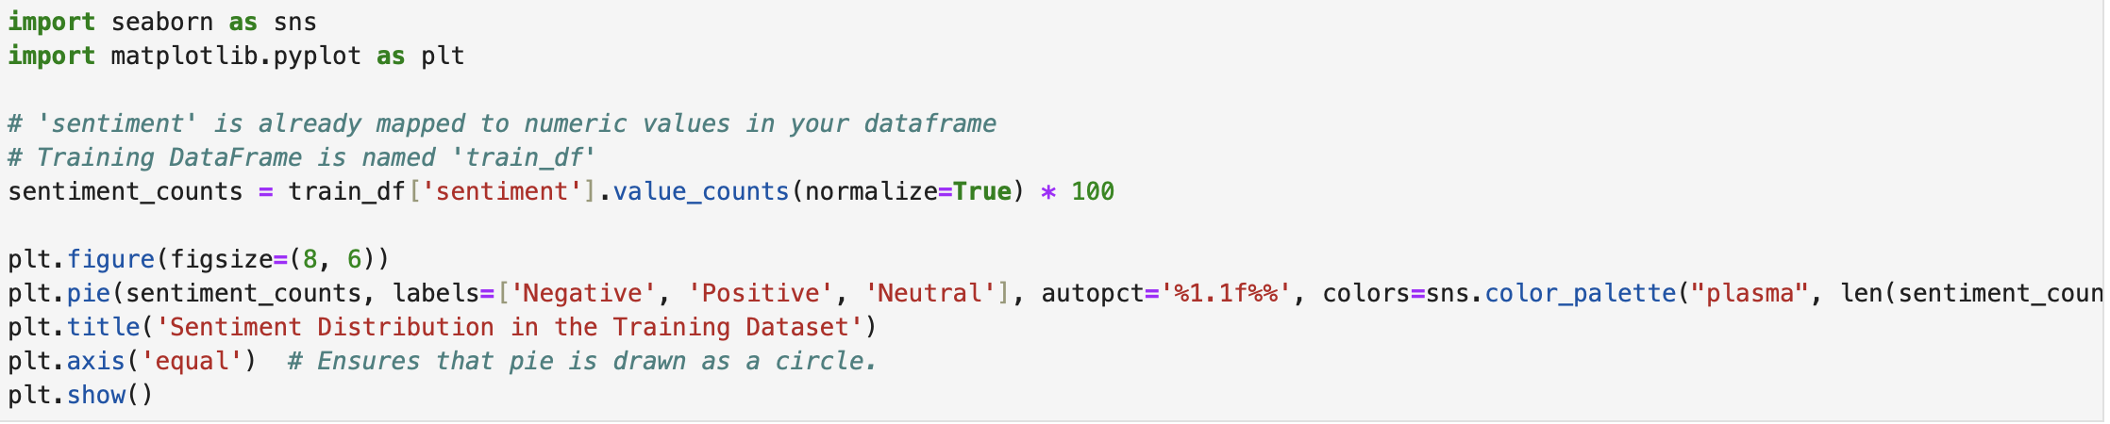
Pie Chart

Slide 10
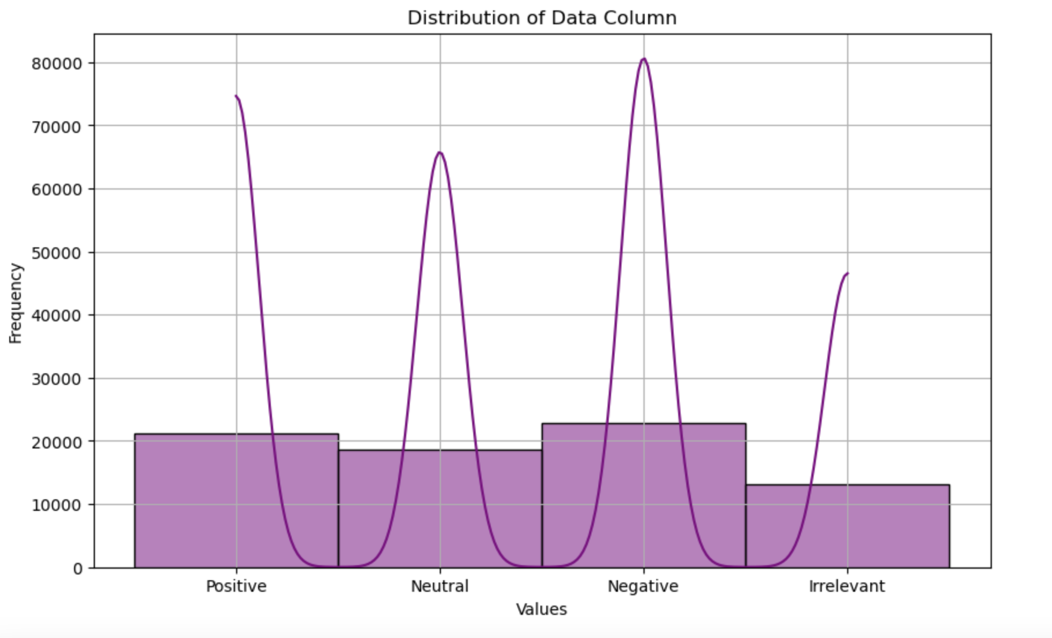
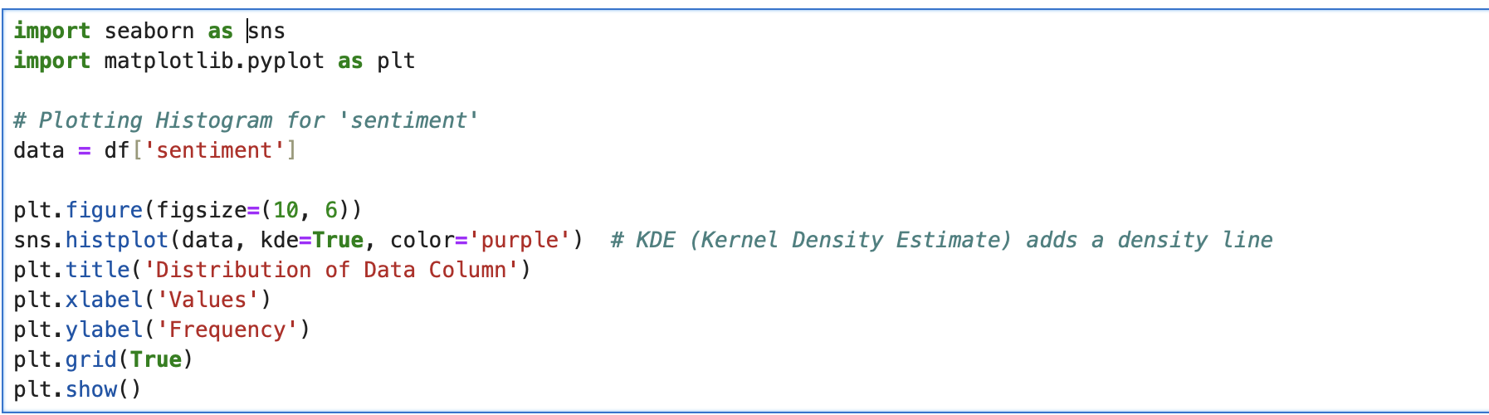
Histogram

Slide 11
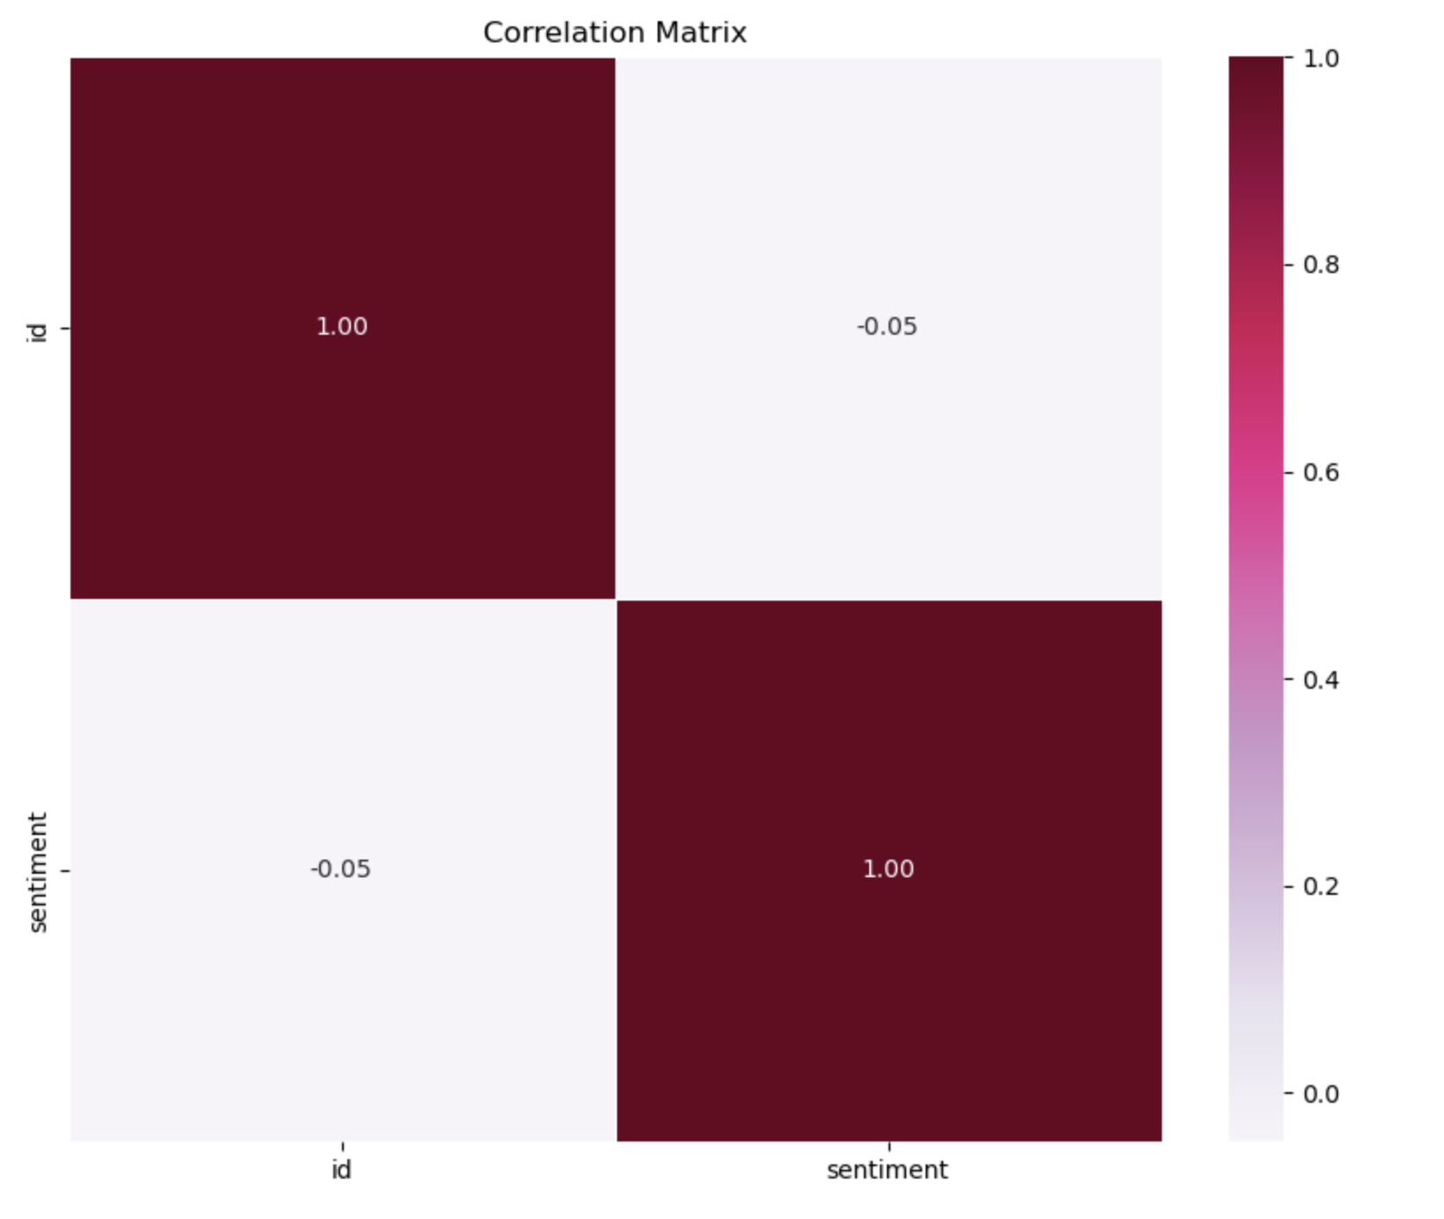
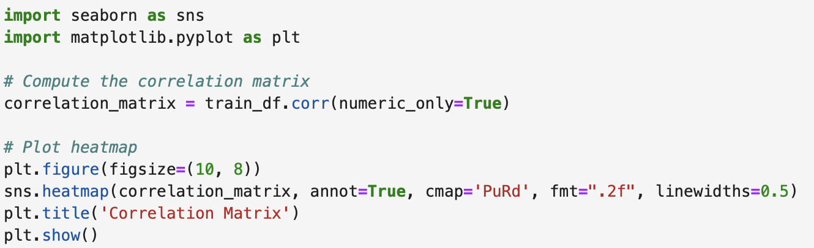
Correlation Matrix

Slide 12
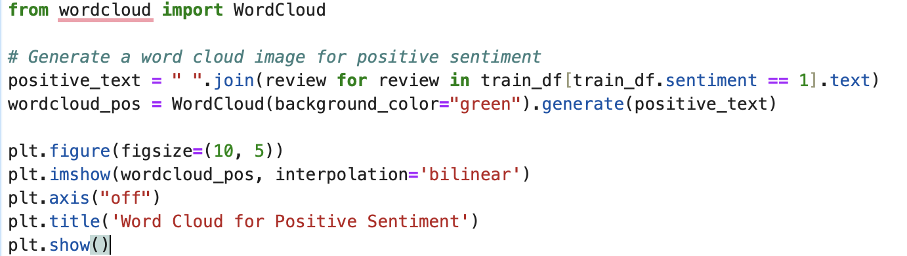
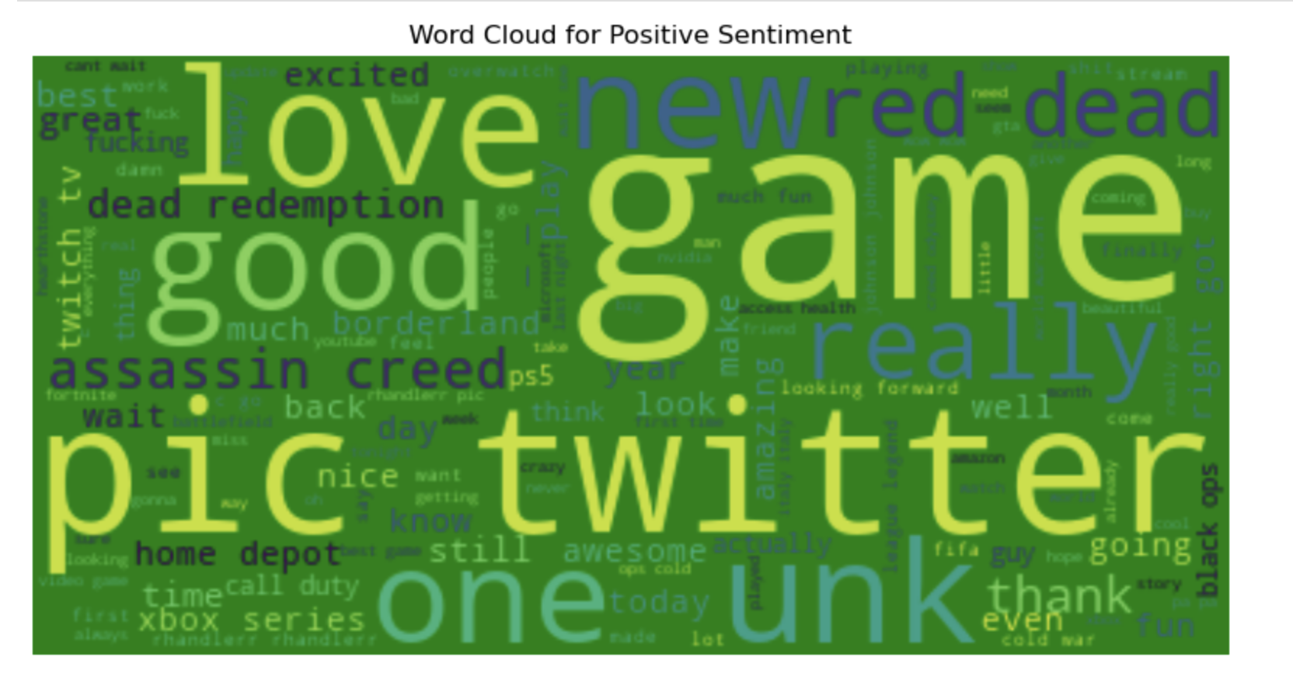
Word Cloud for Positive Sentiment

Slide 13
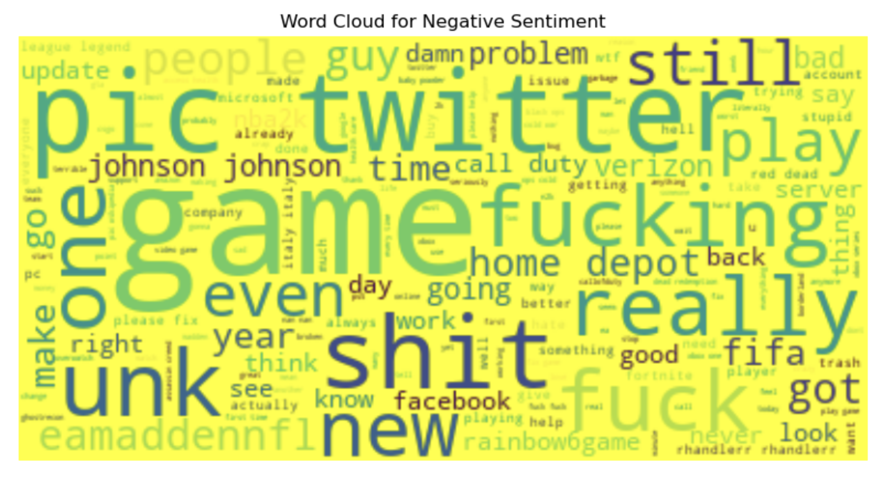
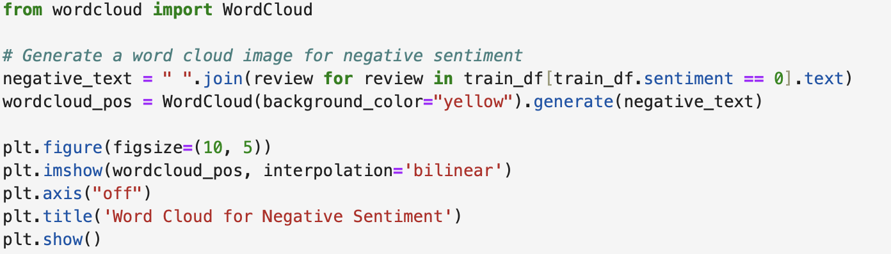
Word Cloud for Negative Sentiment

Slide 14
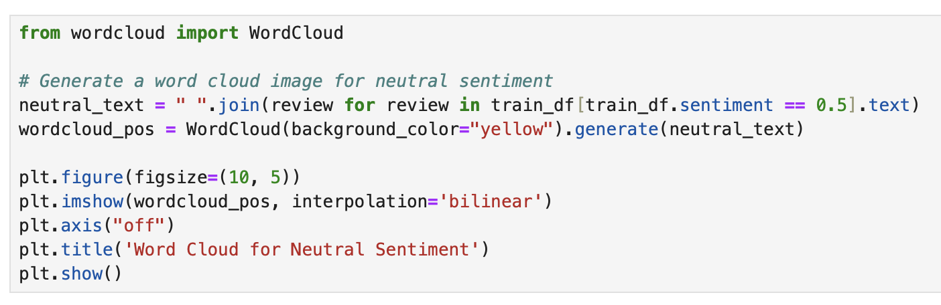
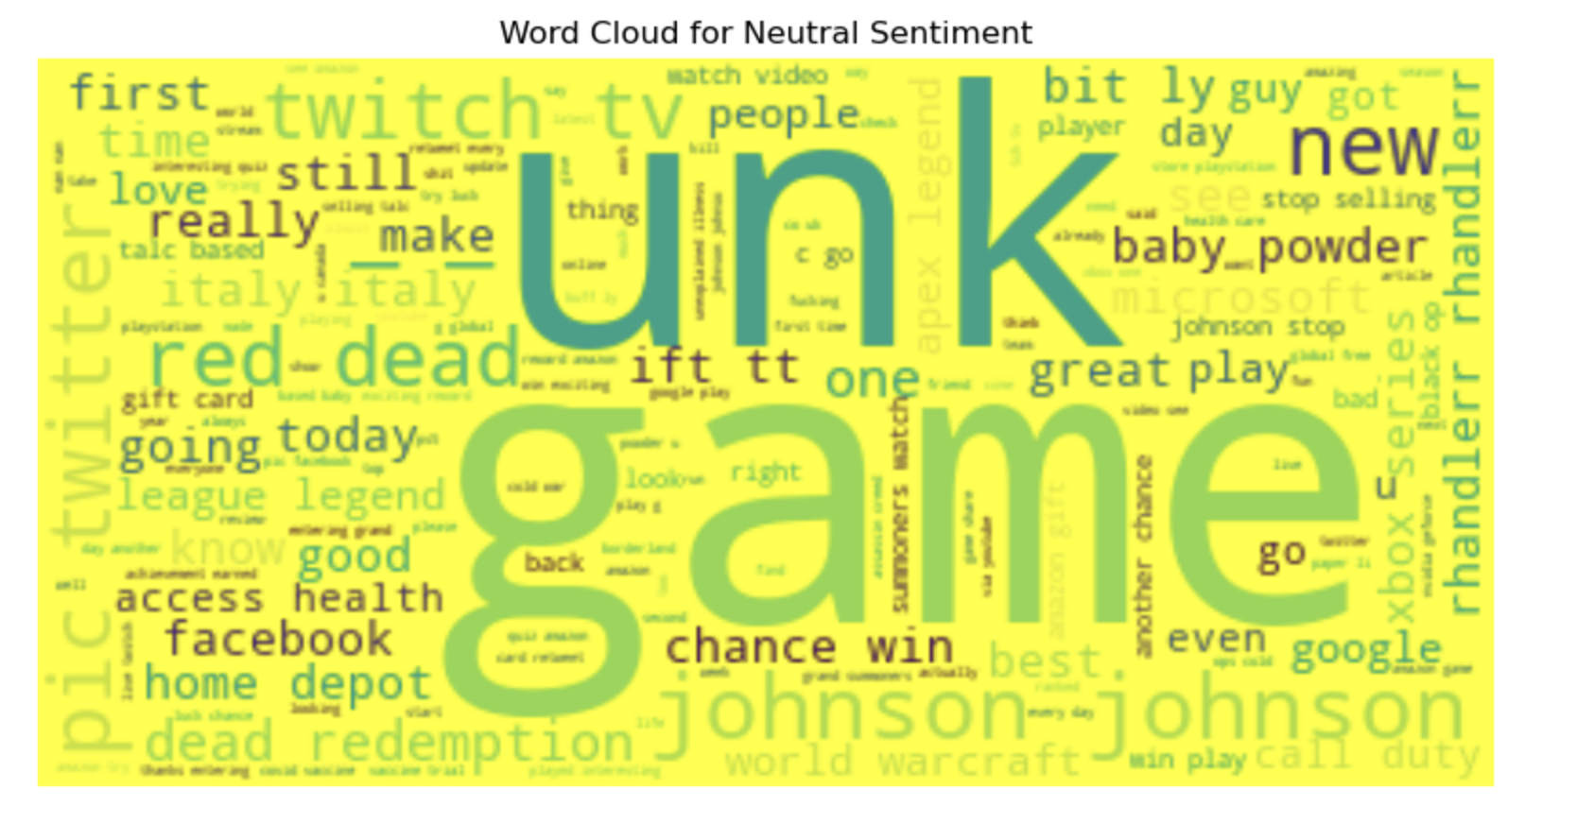
Word Cloud for Neutral Sentiment

Slide 15
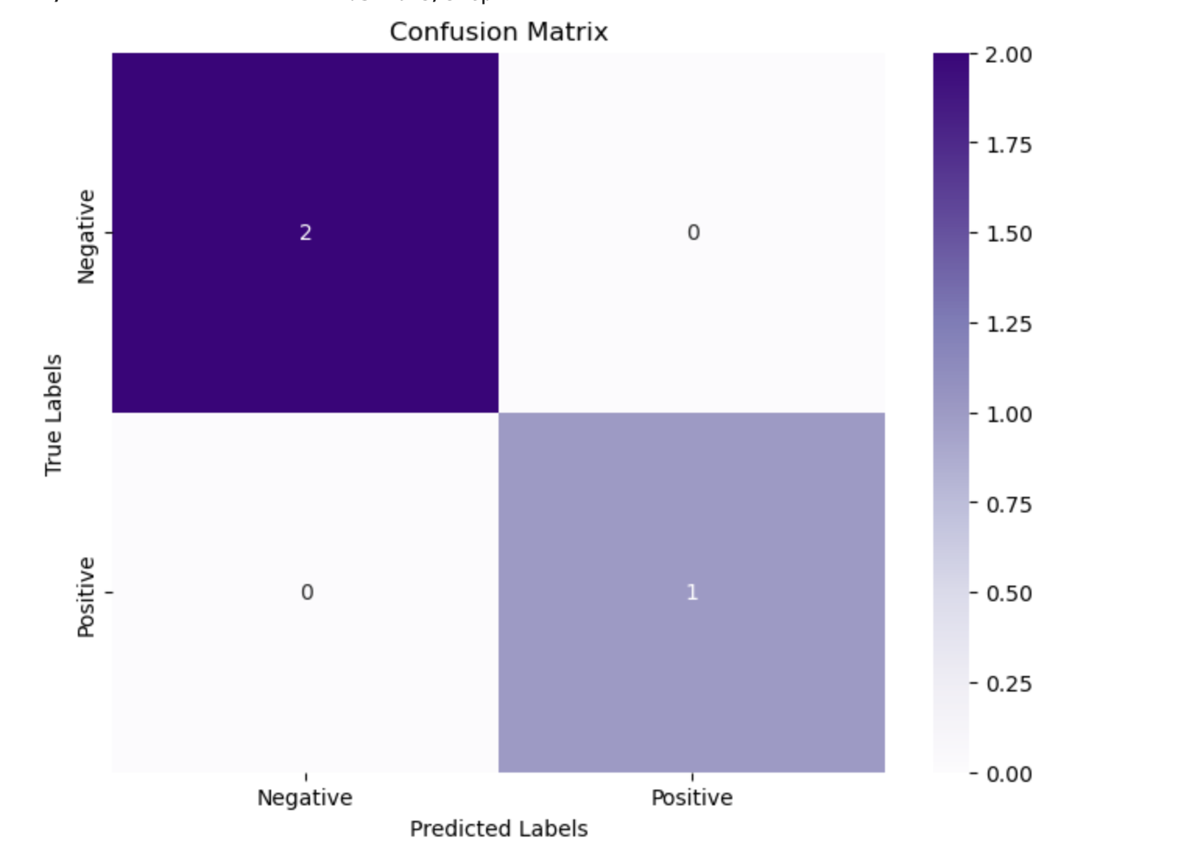
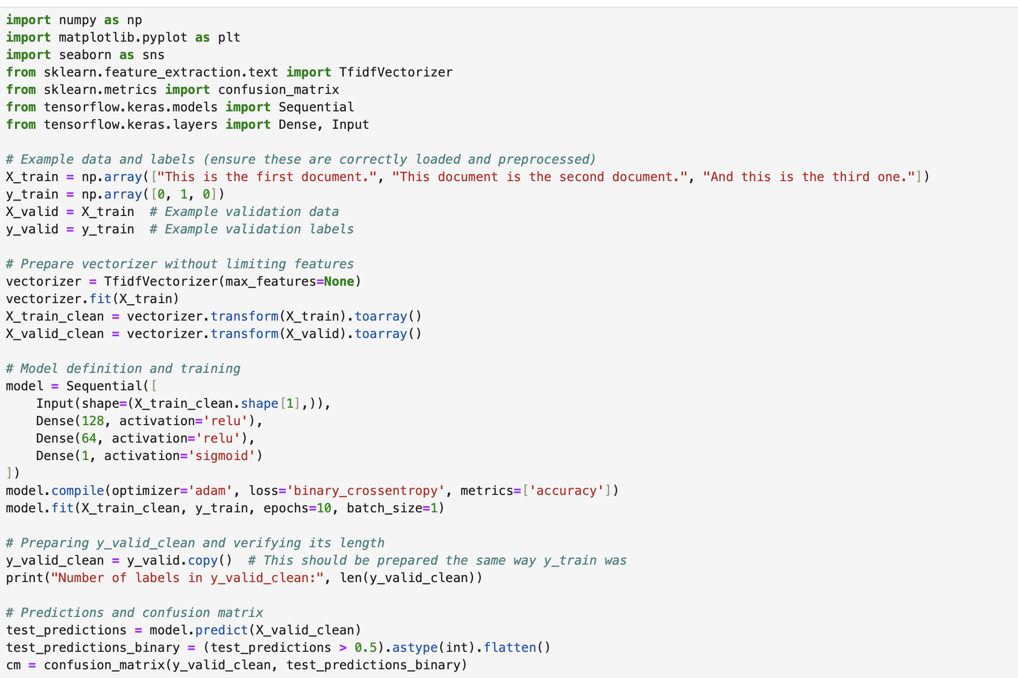
Confusion Matrix

Slide 16
Conclusion
Analyzing sentiment from Twitter data through machine learning offers a powerful approach to capturing and interpreting public emotions at scale. By leveraging automated sentiment classification, businesses and institutions can uncover meaningful insights related to user experiences, brand reputation, and evolving market dynamics. This project highlights the practical application of machine learning in processing social media content and lays the groundwork for future developments in real-time sentiment monitoring and analysis.

Slide 17
THANK YOU

